Slide 1
Big Data Analytics Project
Phase 1
10/13/20

Slide 2

Team Yellow
Alekhya Sangem
Vatsal Shah
Abhishek Shenoy
Akshay Shirsat
Bikram Singh
Meng Sui

Slide 3
Abhishek Shenoy
Member 1
Year-1987

Slide 4
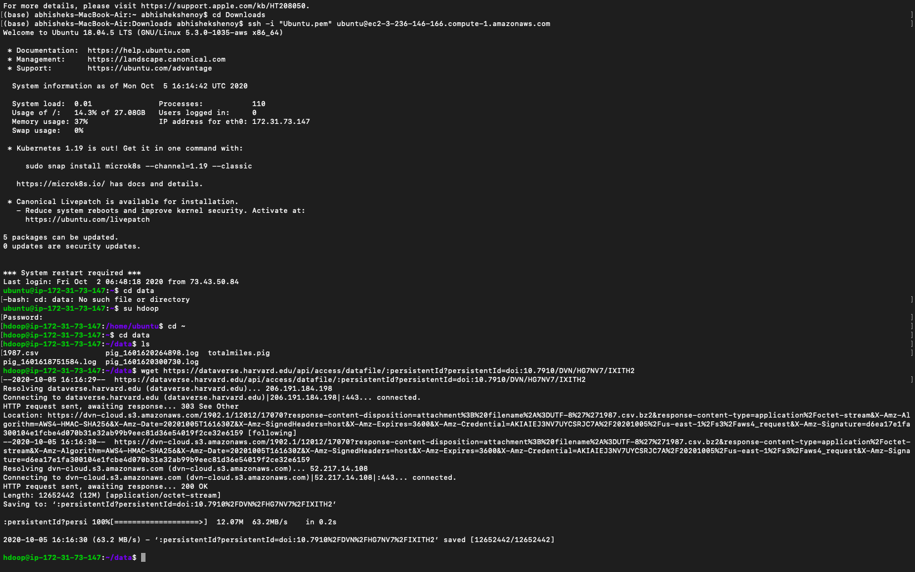
Download & Upload File
Download
Upload

Slide 5
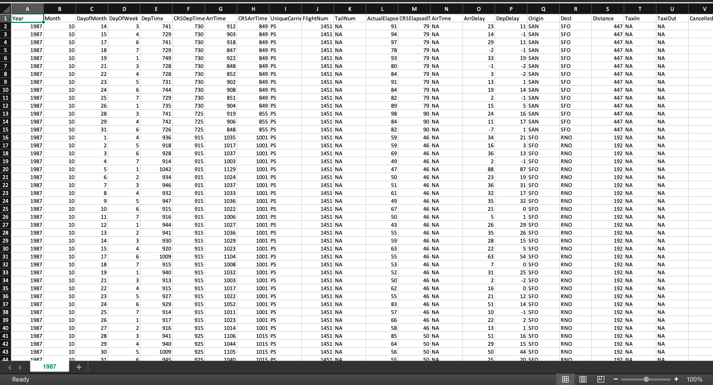
Spreadsheet Output

Slide 6

Script For Highest Delay

Slide 7
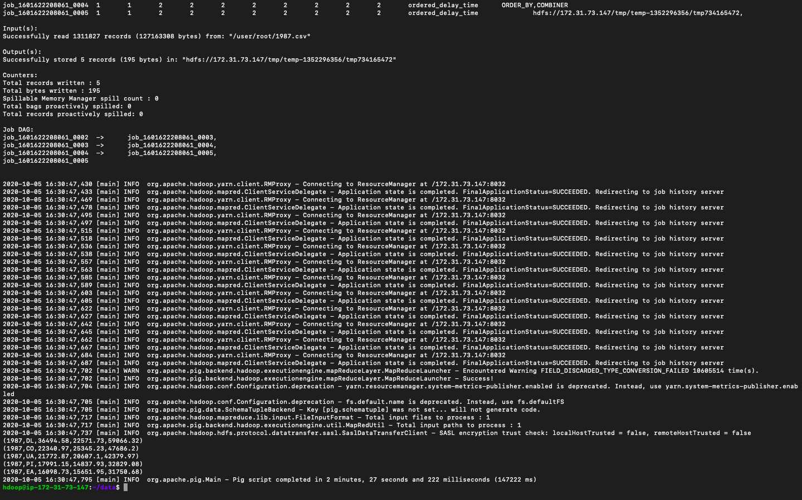
Output of Highest Delay

Slide 8
Output of Highest Delay
Year | Carrier | Arrival Time Delay | Departure Time Delay | Total Time Delay
1987 | DL | 36494.58 | 22571.73 | 59066.32
1987 | CO | 22340.97 | 26345.23 | 47686.2
1987 | UA | 21772.87 | 20607.1 | 42379.97
1987 | PI | 17991.15 | 14837.93 | 32829.08
1987 | EA | 16098.73 | 15651.95 | 31750.68

Slide 9
1987 Highest Delay Airline
The Airlines which experienced highest delay in the year 1987 were:
1. DL - Delta Airlines
2. CO -Continental Airlines
3. UA - United Airlines
4. PI – Piedmont Aviation Inc.
5. EA - Eastern Airlines

Slide 10

Script for Lowest Delay

Slide 11
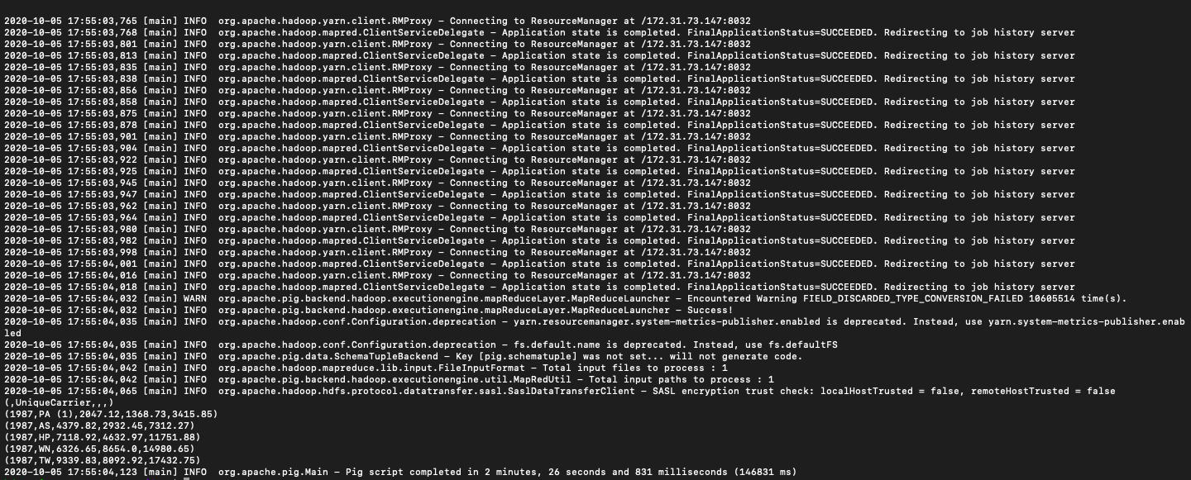
Output of Lowest Delay

Slide 12
Output of Lowest Delay
Year | Carrier | Arrival Time Delay | Departure Time Delay | Total Time Delay
1987 | PA | 2047.12 | 1368.73 | 3415.85
1987 | AS | 4379.82 | 2932.45 | 7312.27
1987 | HP | 7118.92 | 4632.97 | 11751.88
1987 | WN | 6326.65 | 8654.0 | 14980.65
1987 | TW | 9339.83 | 8892.92 | 17432.75

Slide 13
1987 Lowest Delay Airline
The Airlines which experienced lowest delay in the year 1987 were:
1.PA - Florida Coastal Airlines
2.AS - Alaska Airlines
3.HP - America West Airlines Inc
4.WN -Southwest Airlines
5.TW – Trans World Airlines

Slide 14
Akshay Shirsat
Member 2
Year-1988

Slide 15
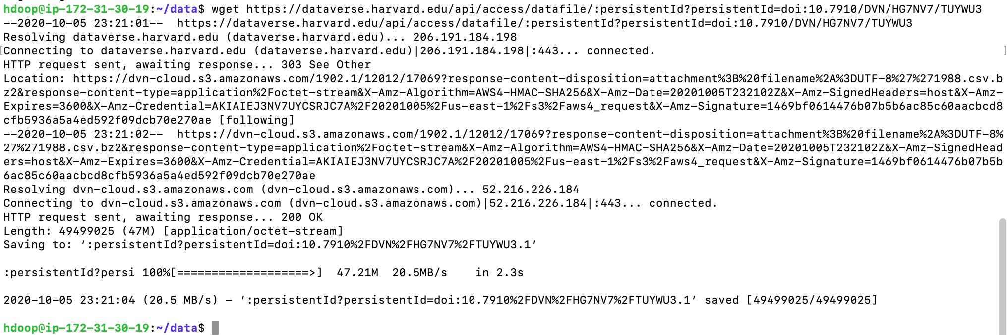
Downloading data in Hadoop
Uploading data in Hadoop

Slide 16
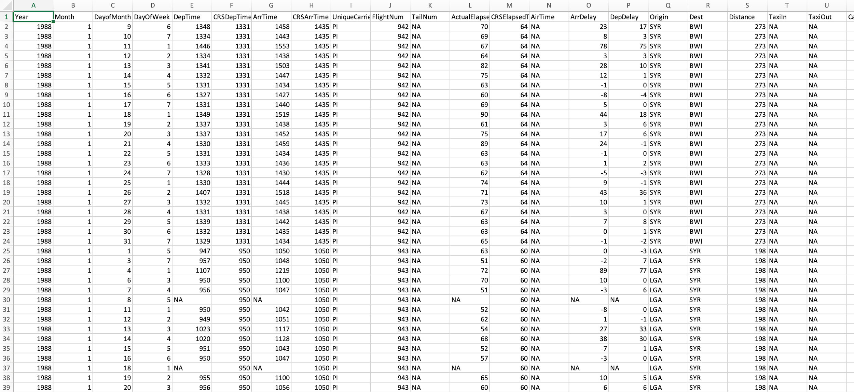
Spreadsheet Output

Slide 17
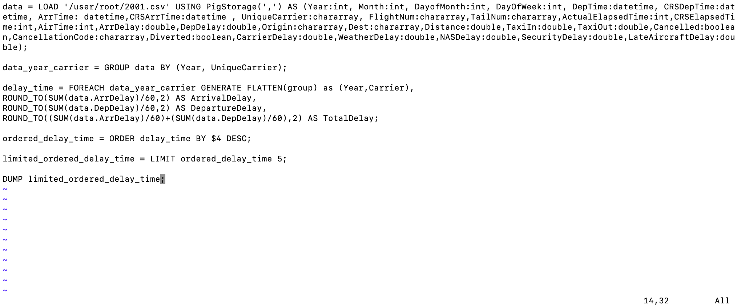
Script for Highest Delay

Slide 18
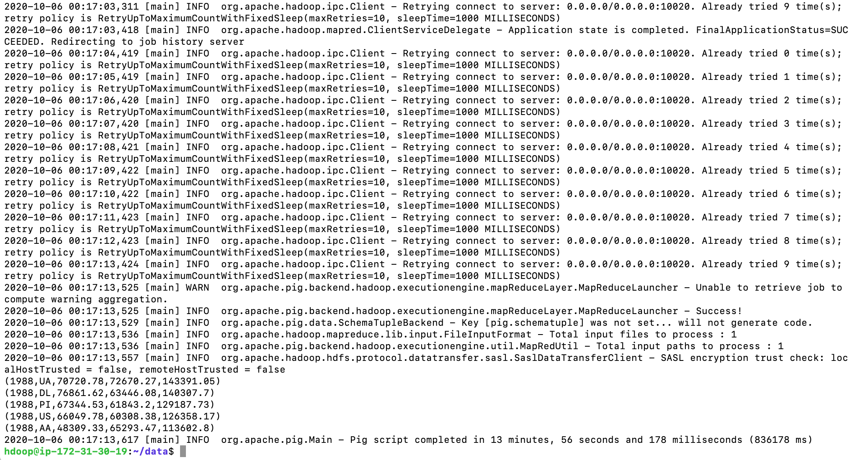
Output of Highest Delay

Slide 19
Output of Highest Delay
Year | Carrier | Arrival Time Date | Departure Time Delay | Total Time Delay
1988 | UA | 70720.78 | 72670.27 | 143391.05
1988 | DL | 76861.62 | 63446.08 | 140307.7
1988 | PI | 67344.53 | 61843.2 | 129187.73
1988 | US | 66049.78 | 60308.38 | 126358.17
1988 | AA | 48309.33 | 65293.47 | 113602.8

Slide 20
The Airlines which experienced highest delay in the year 1988 were: 1. UA - United Airlines 2. DL - Delta Airlines 3. PI - Piedmont Aviation Inc. 4. US – US Airways 5. AA – American Airlines
1988 Highest Delay Airline

Slide 21
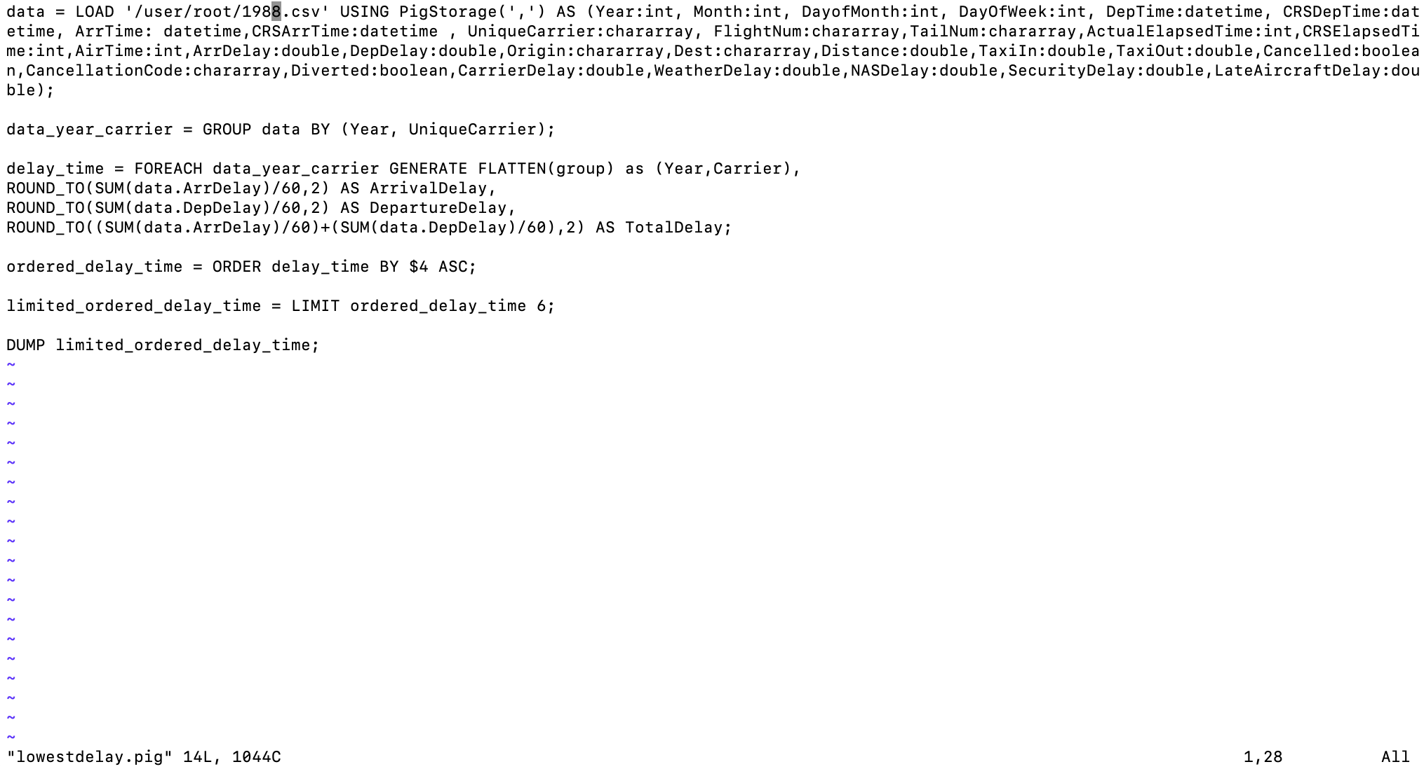
Script for Lowest Delay

Slide 22
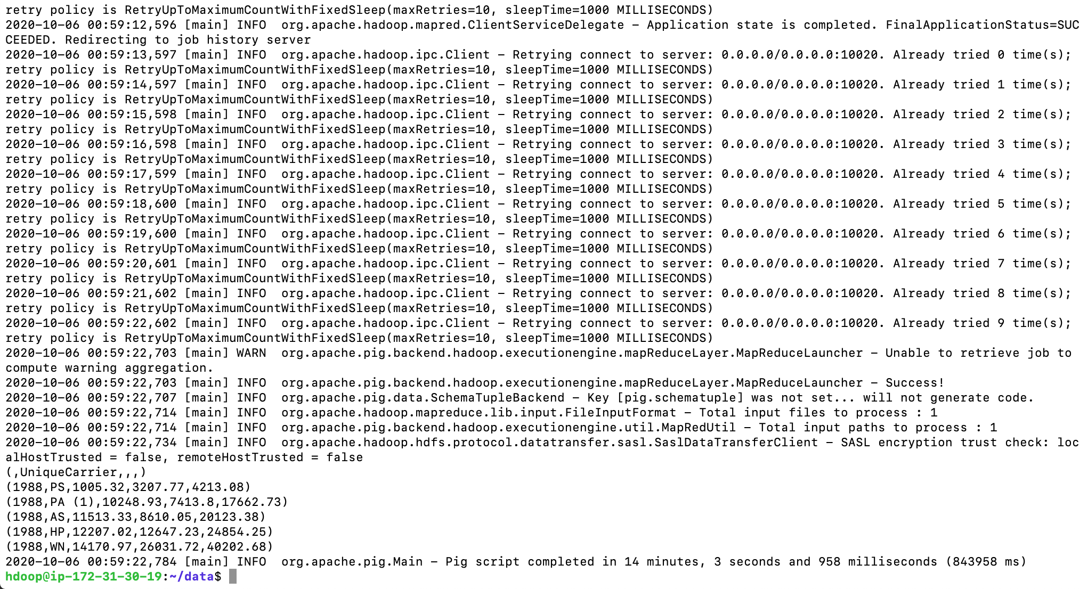
Output for Lowest Delay

Slide 23
Output of Lowest Delay
Year | Carrier | Arrival Time Date | Departure Time Delay | Total Time Delay
1988 | PS | 1005.32 | 3207.77 | 4213.08
1988 | PA | 10248.93 | 7413.8 | 17662.73
1988 | AS | 11513.33 | 8610.05 | 20123.38
1988 | HP | 12207.02 | 12647.23 | 24854.25
1988 | WN | 14170.97 | 26031.72 | 40202.68

Slide 24
The Airlines which experienced lowest delay in the year 1988 were: 1. PS – Pacific Southwest Airlines 2. PA – Florida Coastal Airlines 3. AS – Alaska Airlines 4. HP – America West Airlines Inc 5. WN – Southwest Airlines
1988 Lowest Delay Airline

Slide 25
Member 3
Bikram Singh
Year-1989

Slide 26
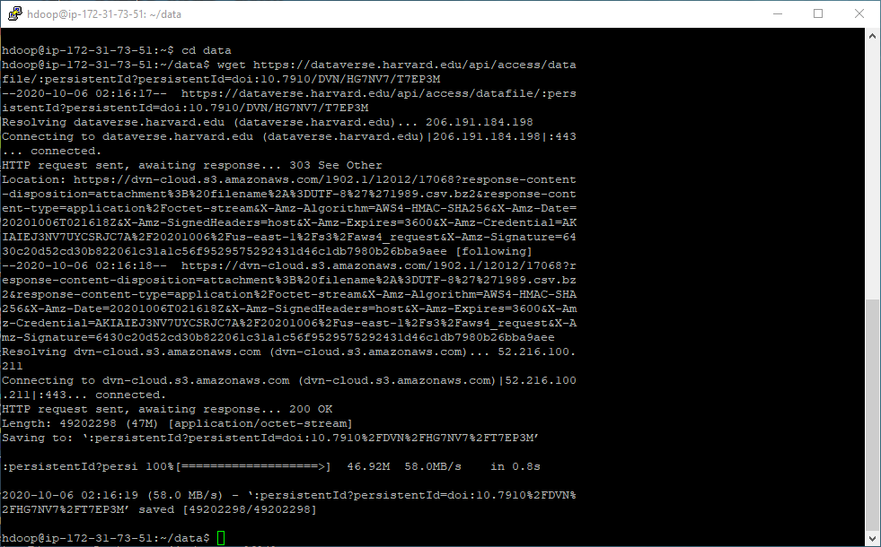
Downloading Data Into Hadoop

Slide 27

Uploading Data Into Hadoop

Slide 28
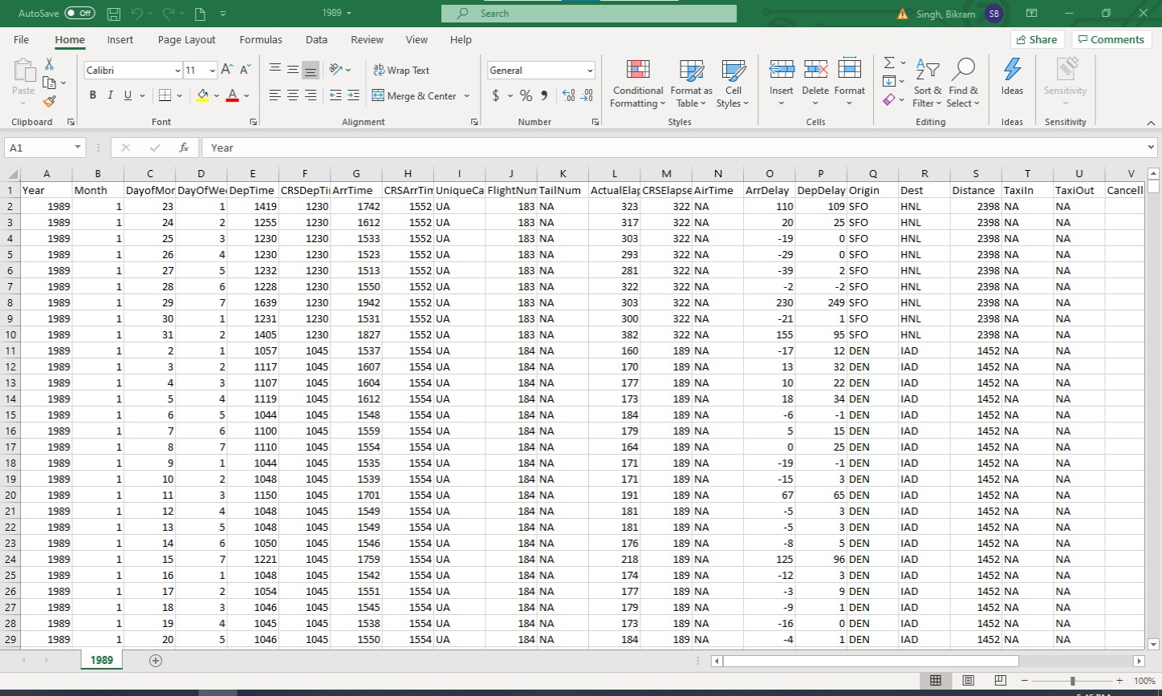
Spreadsheet Output

Slide 29
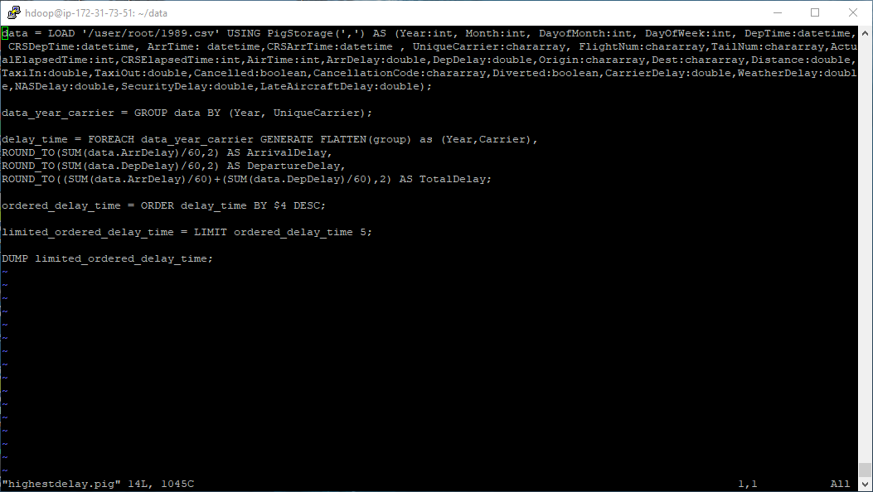
Highest Delay Script

Slide 30
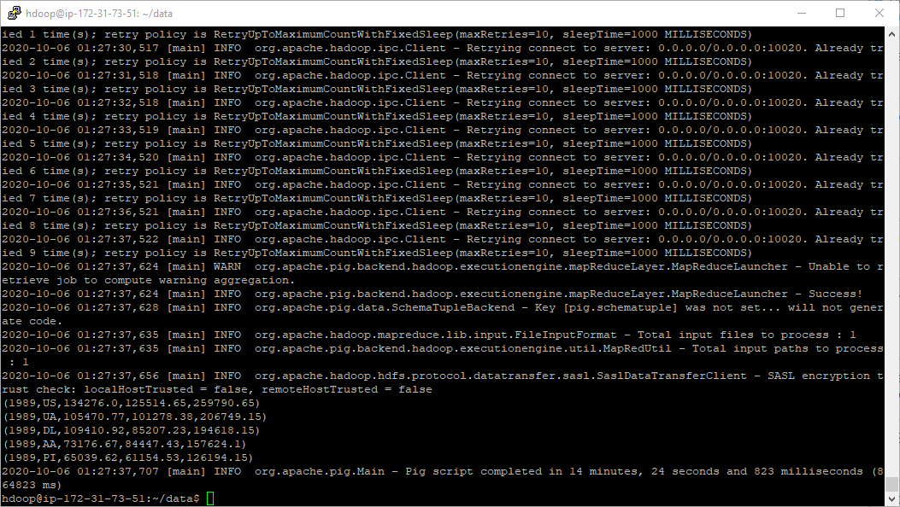
Highest Delay Output

Slide 31
Output of Highest Delay
YEAR | CARRIER | ARRIVAL TIME DELAY | DEPARTURE TIME DELAY | TOTAL TIME DELAY
1989 | US | 134276.0 | 125514.65 | 259790.65
1989 | UA | 105470.77 | 101278.38 | 206749.15
1989 | DL | 109410.92 | 85207.23 | 194618.15
1989 | AA | 73176.67 | 84447.43 | 157624.1
1989 | PI | 65039.62 | 61154.53 | 126194.15

Slide 32
1989 Highest Delay Airline
The airlines which experienced the highest delay in 1989 were:
1.US- US Airways
2.UA- United Airlines
3.DL- Delta Air Lines
4.AA- American Airlines
5.PI- Piedmont Aviation Inc.

Slide 33
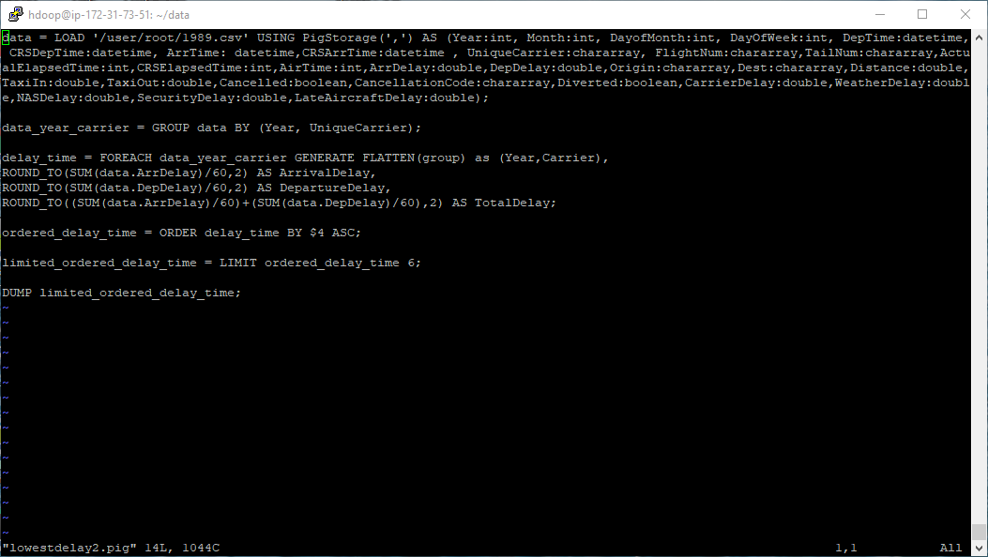
Lowest Delay Script

Slide 34
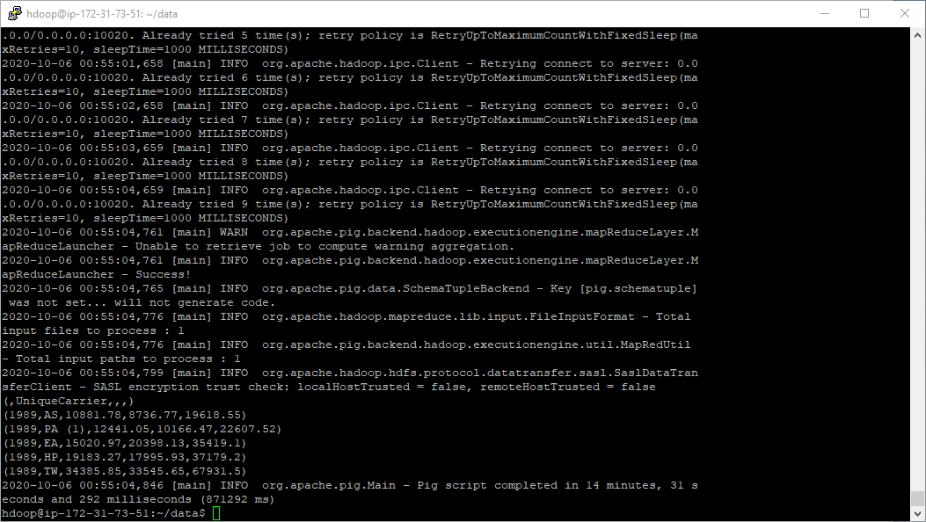
Lowest Delay Output

Slide 35
Output of Lowest Delay
YEAR | CARRIER | ARRIVAL TIME DELAY | DEPARTURE TIME DELAY | TOTAL TIME DELAY
1989 | AS | 10881.78 | 8736.77 | 19618.55
1989 | PA (1) | 12441.05 | 10166.47 | 22607.52
1989 | EA | 15020.97 | 20398.13 | 35419.1
1989 | HP | 19183.27 | 17995.93 | 37179.2
1989 | TW | 34385.85 | 33545.65 | 67931.5

Slide 36
1989 Lowest Delay Airline
The airlines which experienced the lowest delay in 1989 were:
1.AS- Alaska Airlines
2.PA(1)- Pan American World Airways (1)
3.EA- European Air Express
4.HP- America West Airlines Inc
5.TW- Trans World Airlines

Slide 37
Member 4
Vatsal Shah
Year-1990

Slide 38
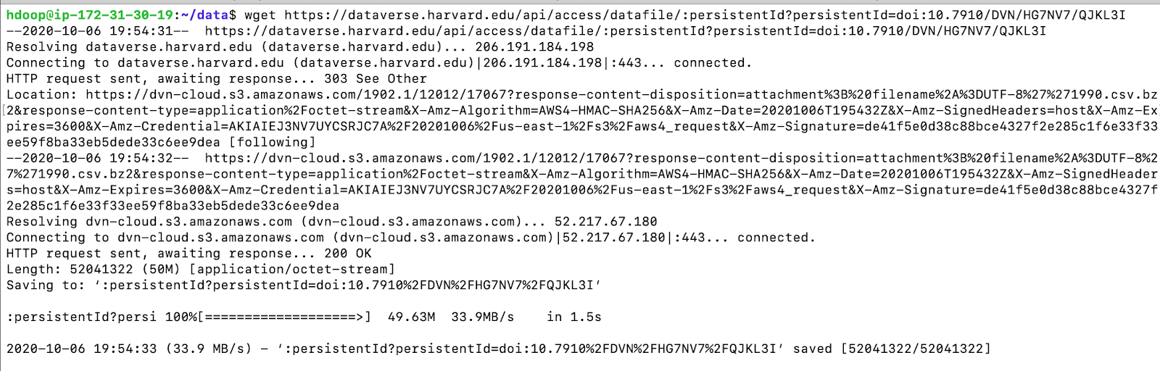
Downloading data in Hadoop
Uploading data in Hadoop

Slide 39
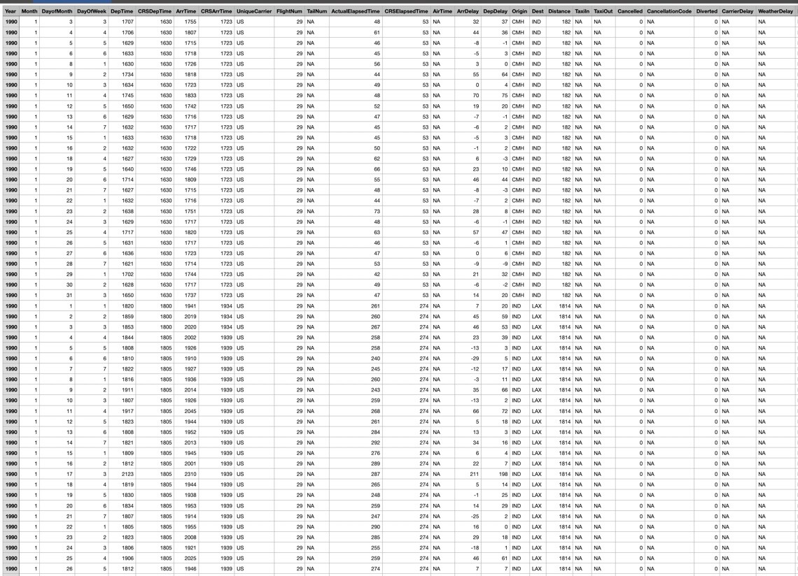
Spreadsheet Output

Slide 40
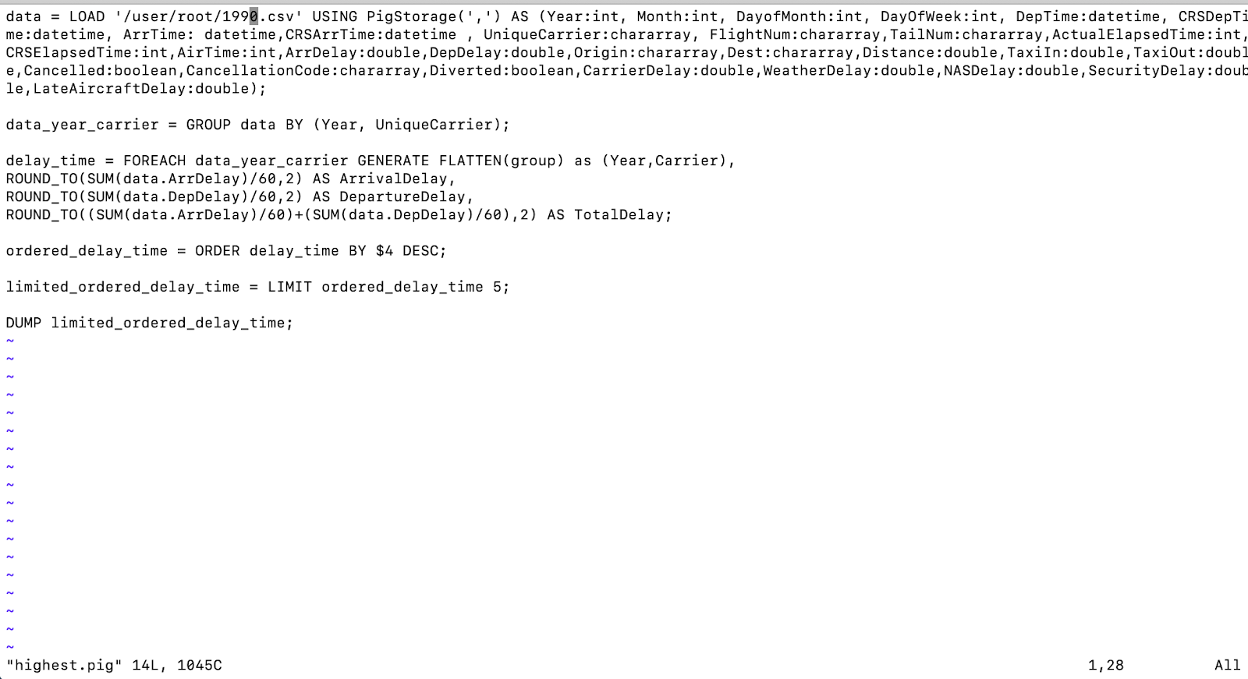
Script for Highest Delay

Slide 41

Output of Highest Delay

Slide 42
Output of Highest Delay
Year | Carrier | Arrival Time Delay | Departure Time Delay | Total Time Delay
1990 | DL | 128534.3 | 102674.52 | 231208.82
1990 | US | 98865.33 | 101859.3 | 200724.63
1990 | AA | 76025.15 | 78138.25 | 154163.4
1990 | UA | 74095.35 | 77315.63 | 151410.98
1990 | CO | 54943.28 | 50123.05 | 105066.33

Slide 43
The Airlines which experienced highest delay in the year 1990 were:
1. DL - Delta Airlines
2. US - USAirways
3. AA - American Airlines, Inc.
4. UA - United Airlines
5. CO - Continental Airlines
1990 Highest Delay Airline

Slide 44
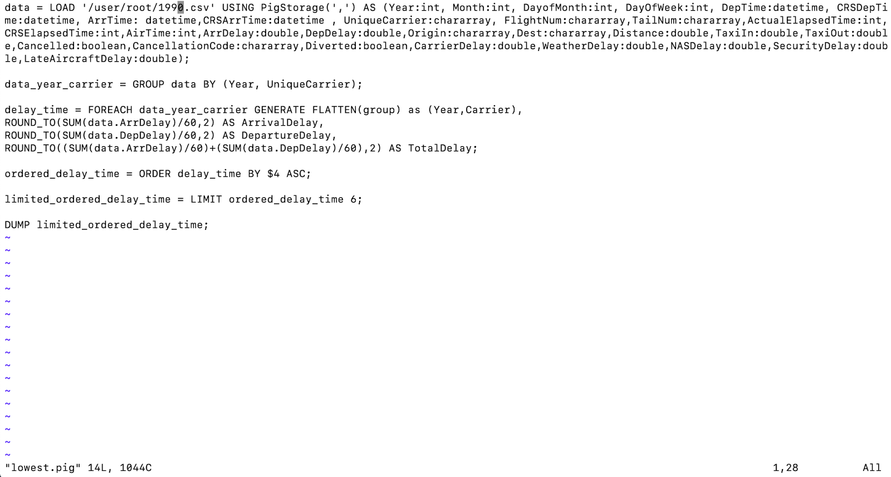
Script for Lowest Delay

Slide 45

Output for Lowest Delay

Slide 46
Output of Lowest Delay
Year | Carrier | Arrival Time Delay | Departure Time Delay | Total Time Delay
1990 | PA | 2703.25 | 6343.8 | 9047.05
1990 | AS | 11342.32 | 8883.1 | 20225.42
1990 | HP | 20434.55 | 23019.88 | 43454.43
1990 | EA | 25261.1 | 36603.15 | 61864.25
1990 | TW | 32324.4 | 31443.63 | 63768.03

Slide 47
The Airlines which experienced lowest delay in the year 1990 were: 1. PA-Florida Coastal Airlines 2. AS-Alaska Airlines 3. HP-America West Airlines Inc 4. EA-European Air Express 5. TW-Trans World Airlines
1990 Lowest Delay Airline

Slide 48
Alekhya Sangem
Member 5
Year-1991

Slide 49
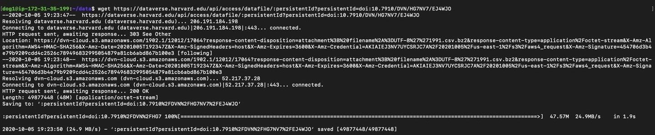
Downloading Data For Hadoop
Uploading Data For Hadoop

Slide 50
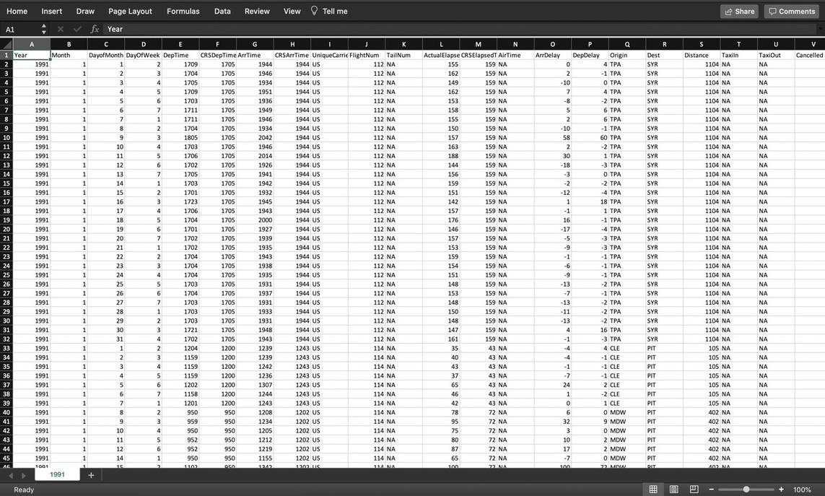
Spreadsheet Output

Slide 51

Script For Highest Delay

Slide 52

Output of Highest Delay

Slide 53
Output For Highest Delay
Year | Carrier | Arrival Time Delay | Departure Time Delay | Total Time Delay
1991 | DL | 97219.5 | 101267.42 | 198486.92
1991 | CO | 68781.37 | 78954.57 | 147735.93
1991 | UA | 58760.37 | 71449.03 | 130209.4
1991 | PI | 46319.05 | 56490.05 | 102809.1
1991 | EA | 31785.43 | 42868.62 | 74654.05

Slide 54
1991 Highest Delay Airline
The Airlines which experienced highest delay in the year 1991 were:
1. DL - Delta Airlines
2. CO -Continental Airlines
3. UA - United Airlines
4. PI - Piedmont Aviation Inc.
5. EA - Eastern Airlines Inc.

Slide 55

Script for Lowest Delay

Slide 56
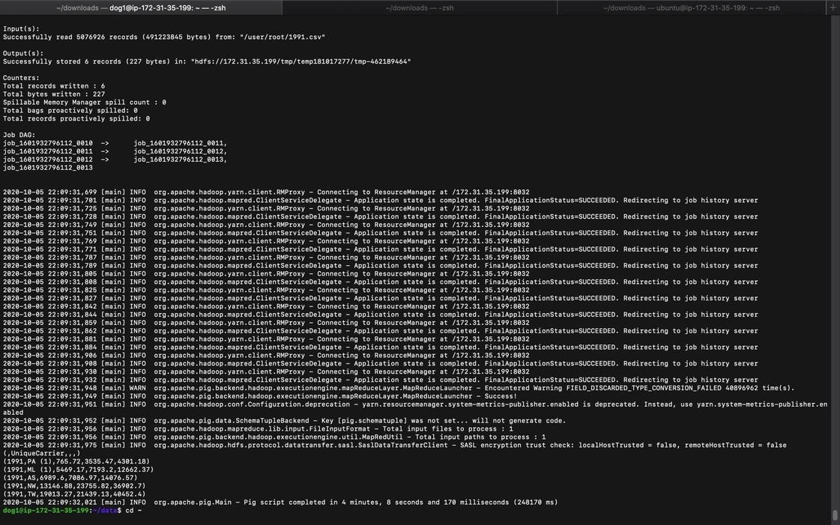
Output of Lowest Delay

Slide 57
Output For Lowest Delay
Year | Carrier | Arrival Time Delay | Departure Time Delay | Total Time Delay
1991 | PA | 765.72 | 3535.47 | 4301.18
1991 | ML | 5469.17 | 7193.2 | 12662.37
1991 | AS | 6989.6 | 7086.97 | 14076.57
1991 | NW | 13146.88 | 23755.82 | 36902.7
1991 | TW | 19013.27 | 21439.13 | 40452.4

Slide 58
1991 Lowest Delay Airline
The airlines which expected lowest delay in the year 1991 are:
1. PA-Florida Coastal Airlines
2. ML-Midway Airlines
3. AS-Alaska Airlines
4. NW-North West Airlines
5. TW-Trans World Airlines

Slide 59
Meng Sui
Member 6
Year-2001

Slide 60
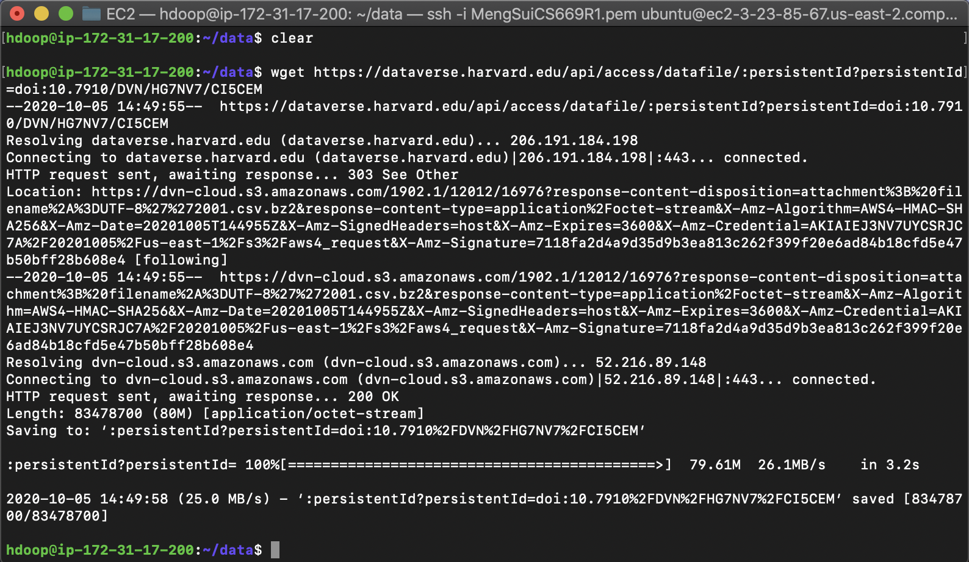
Download and Upload File
Download
Upload

Slide 61
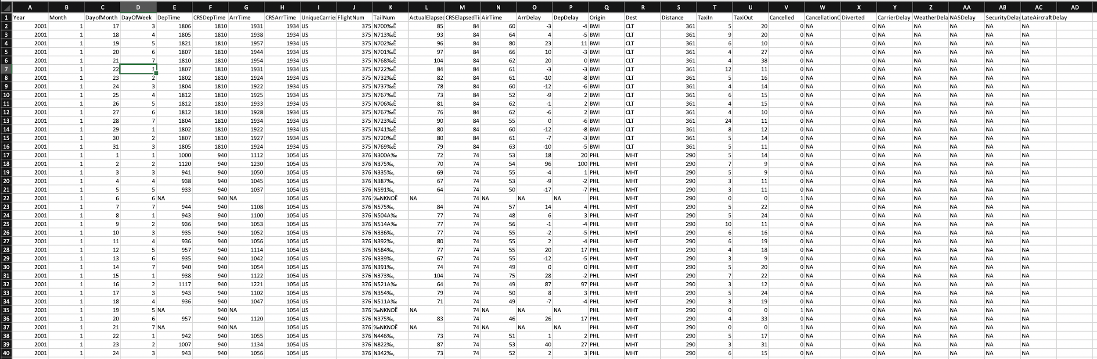
Spreadsheet Output

Slide 62
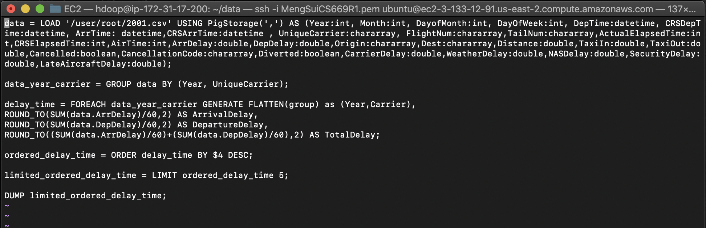
Script for highest Delay

Slide 63
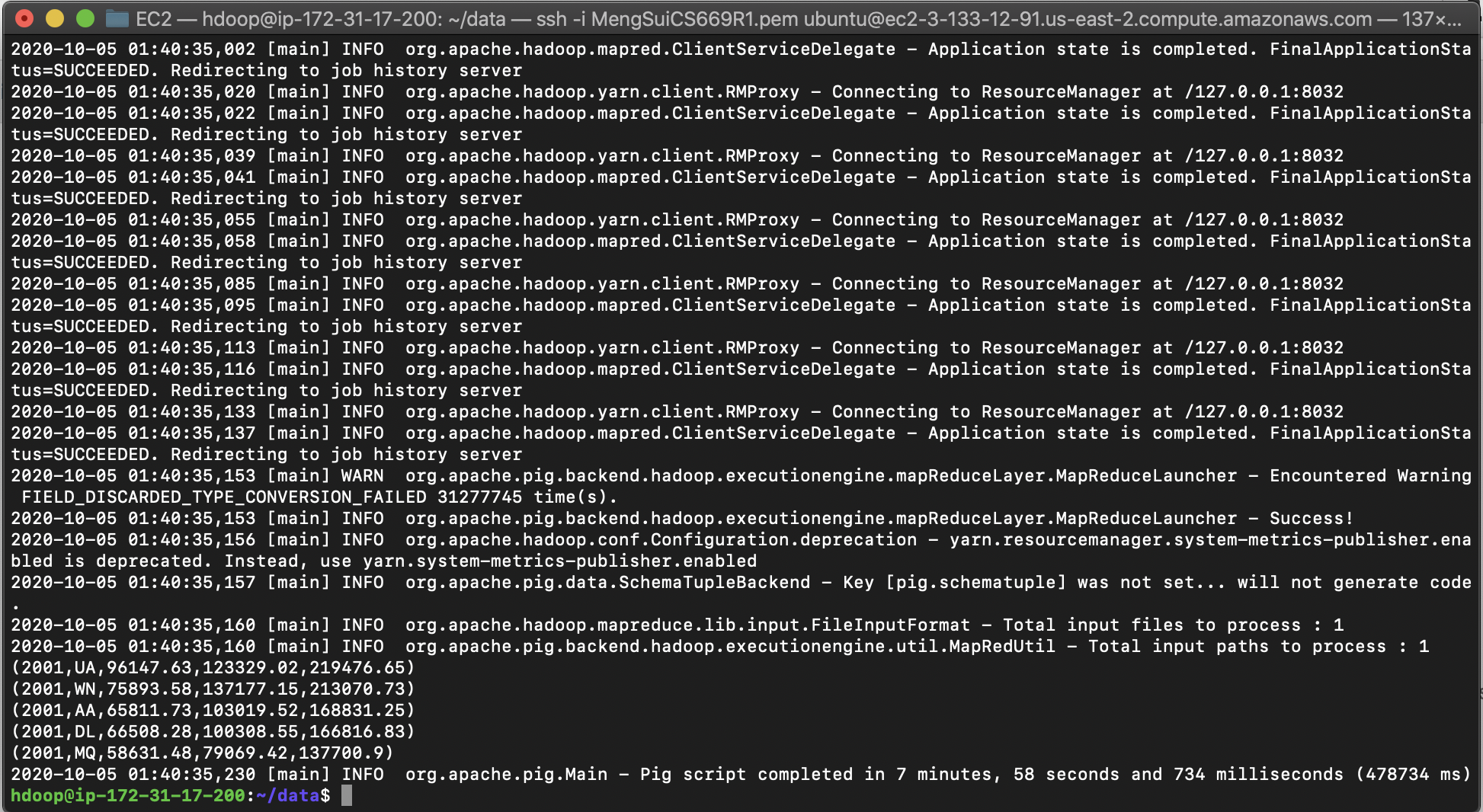
Output of Highest Delay

Slide 64
Output of Highest Delay
Year | Carrier | Arrival Time Delay | Departure Time Delay | Total Time Delay
2001 | UA | 96147.63 | 123329.02 | 219476.65
2001 | WN | 75893.58 | 137177.15 | 213070.73
2001 | AA | 65811.73 | 103019.52 | 168831.25
2001 | DL | 66508.28 | 100308.55 | 166816.83
2001 | MQ | 58631.48 | 79069.42 | 137700.90

Slide 65
2001 Highest Delay Airline
The Airlines which experienced highest delay in the year 2001 were:
1. UA - United Airlines
2. WN - Southwest Airlines
3. AA - American Airlines
4. DL - Delta Air Lines
5. MQ - Envoy Air

Slide 66
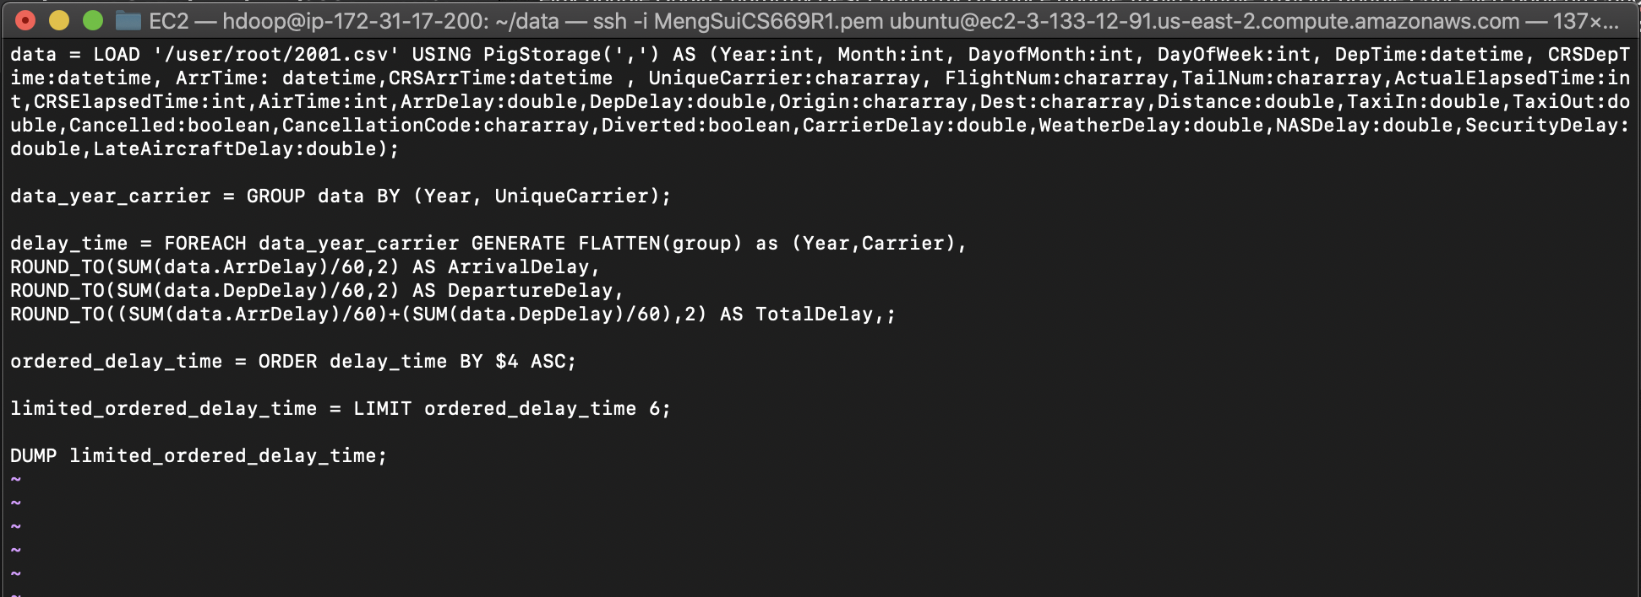
Script for Lowest delay

Slide 67
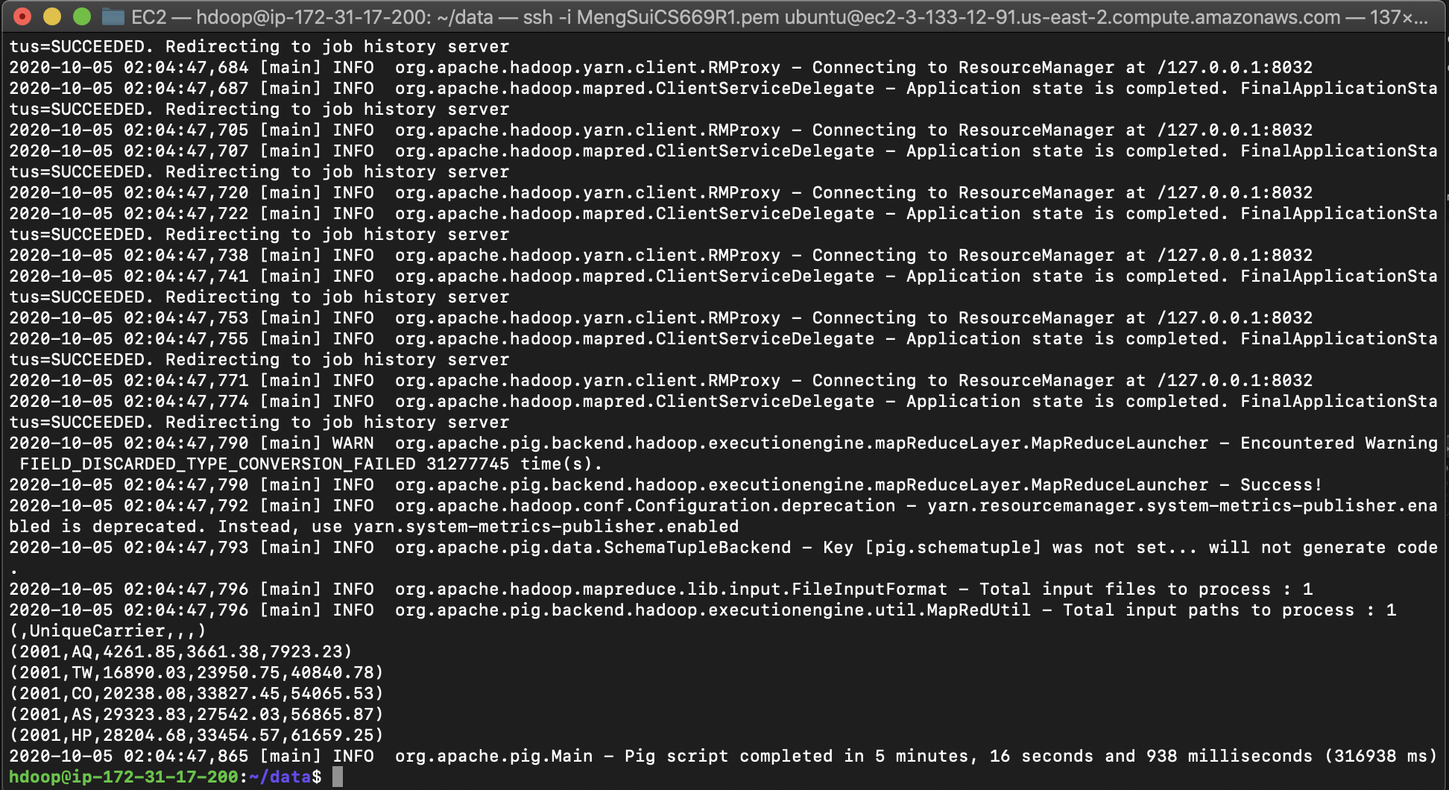
Output of Lowest Delay

Slide 68
Output of Lowest Delay
Year | Carrier | Arrival Time Delay | Departure Time Delay | Total Time Delay
2001 | AQ | 4261.85 | 13661.38 | 17923.23
2001 | TW | 16890.03 | 23950.75 | 40840.78
2001 | CO | 20238,08 | 33827.45 | 54065.53
2001 | AS | 29323.83 | 27542.03 | 56865.87
2001 | HP | 28204.68 | 33454.57 | 61659.25

Slide 69
2001 Lowest Delay Airline
The Airlines which experienced lowest delay in the year 2001 were:
1. AQ - Aloha Airlines Inc.
2.TW -Trans World Airlines
3.CO - Continental Airlines
4.AS- Alaska Airlines
5.HP - America West Airlines Inc

Slide 70

Conclusion

Slide 71
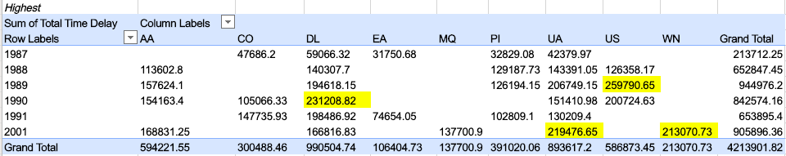
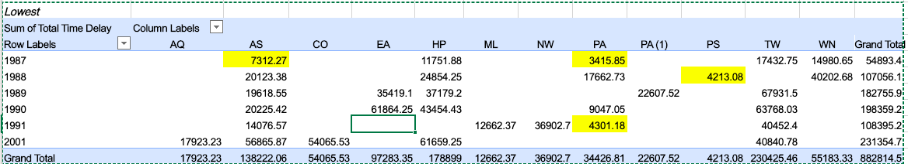
Highest Total Delay
Lowest Total Delay

Slide 72
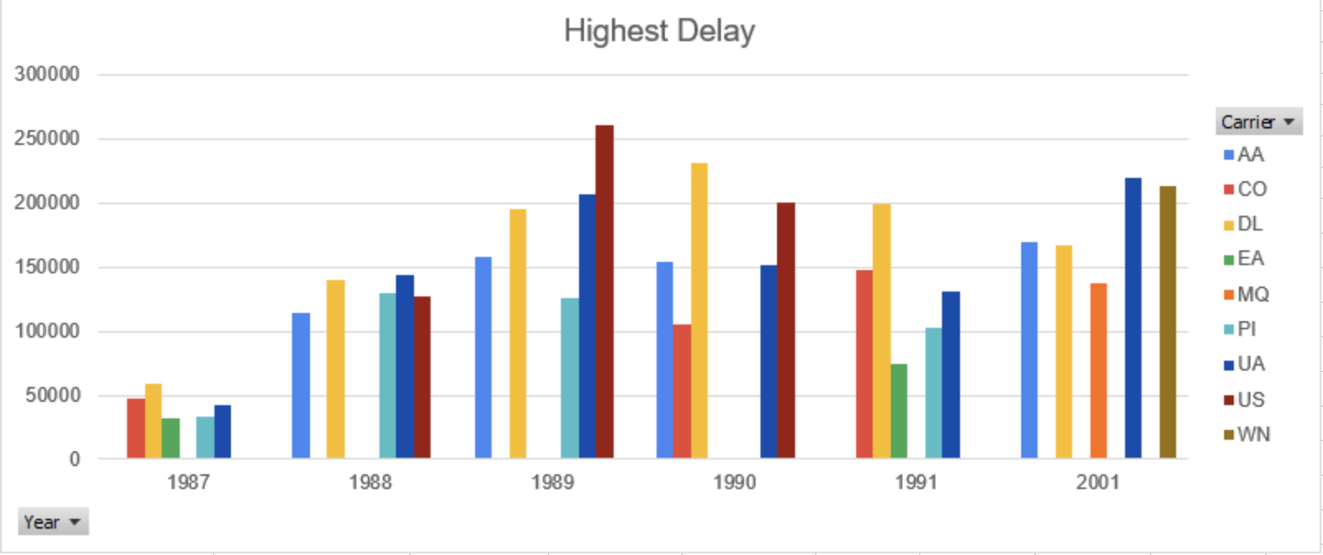

Slide 73
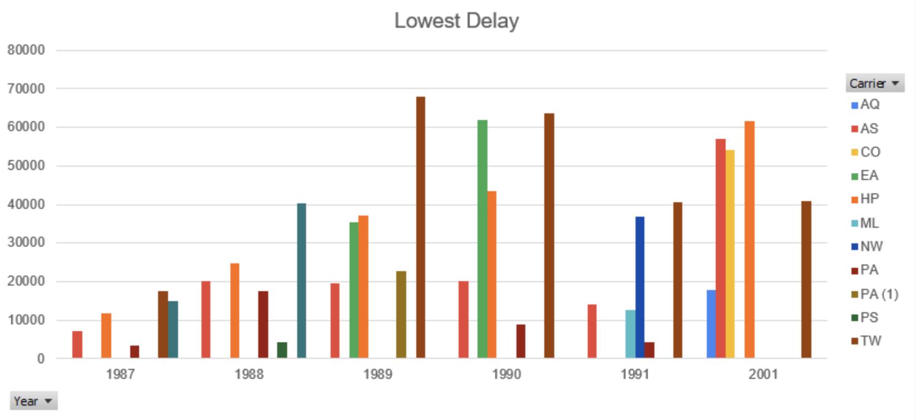

Slide 74
Thank you
Yellow Team - 10/13/20

